Slide 1
Ruby on Rails Application: Furious Fitness
Daniel Kehoe 20057589
Web Server Programming

Slide 2
Application Description
The application is for use in a fitness centre, which will have members and trainers. Trainers will run exercise classes in which members can partake in, each exercise class will have one trainer but have many members.
Trainers can also publish articles to be read by other members and trainers, and members then have the option to leave comments on the articles.

Slide 3
User Features
Trainers can create new exercise classes, also edit or remove
Members can view available classes and book to attend any class, also cancel bookings – members attending is listed on individual class
Trainers can add new articles, with the ability to enable/disable comments
Trainers can edit and update or remove articles
Members can view all or individual articles and leave comments
All users can edit their profile information, with trainers having the ability to delete members
On users profile page they will see listed their current class attendances, or in the case of the user being a trainer they will see their own classes
The users homepage will show a list of recent articles and allow them to click any and go to that article

Slide 4
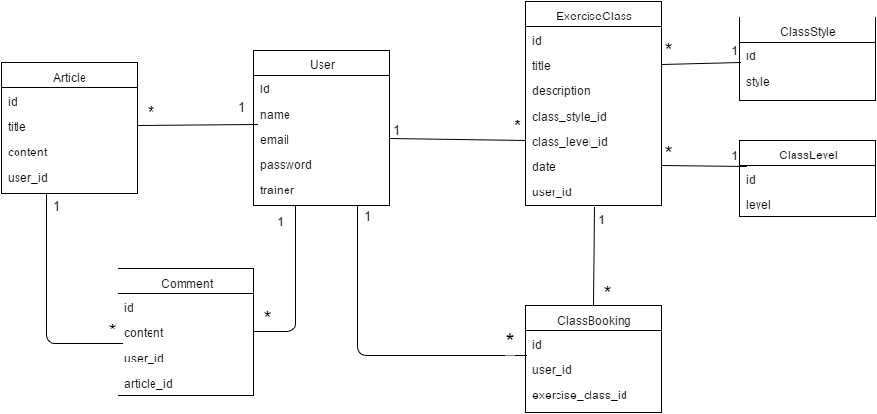
Class Diagram

Slide 5
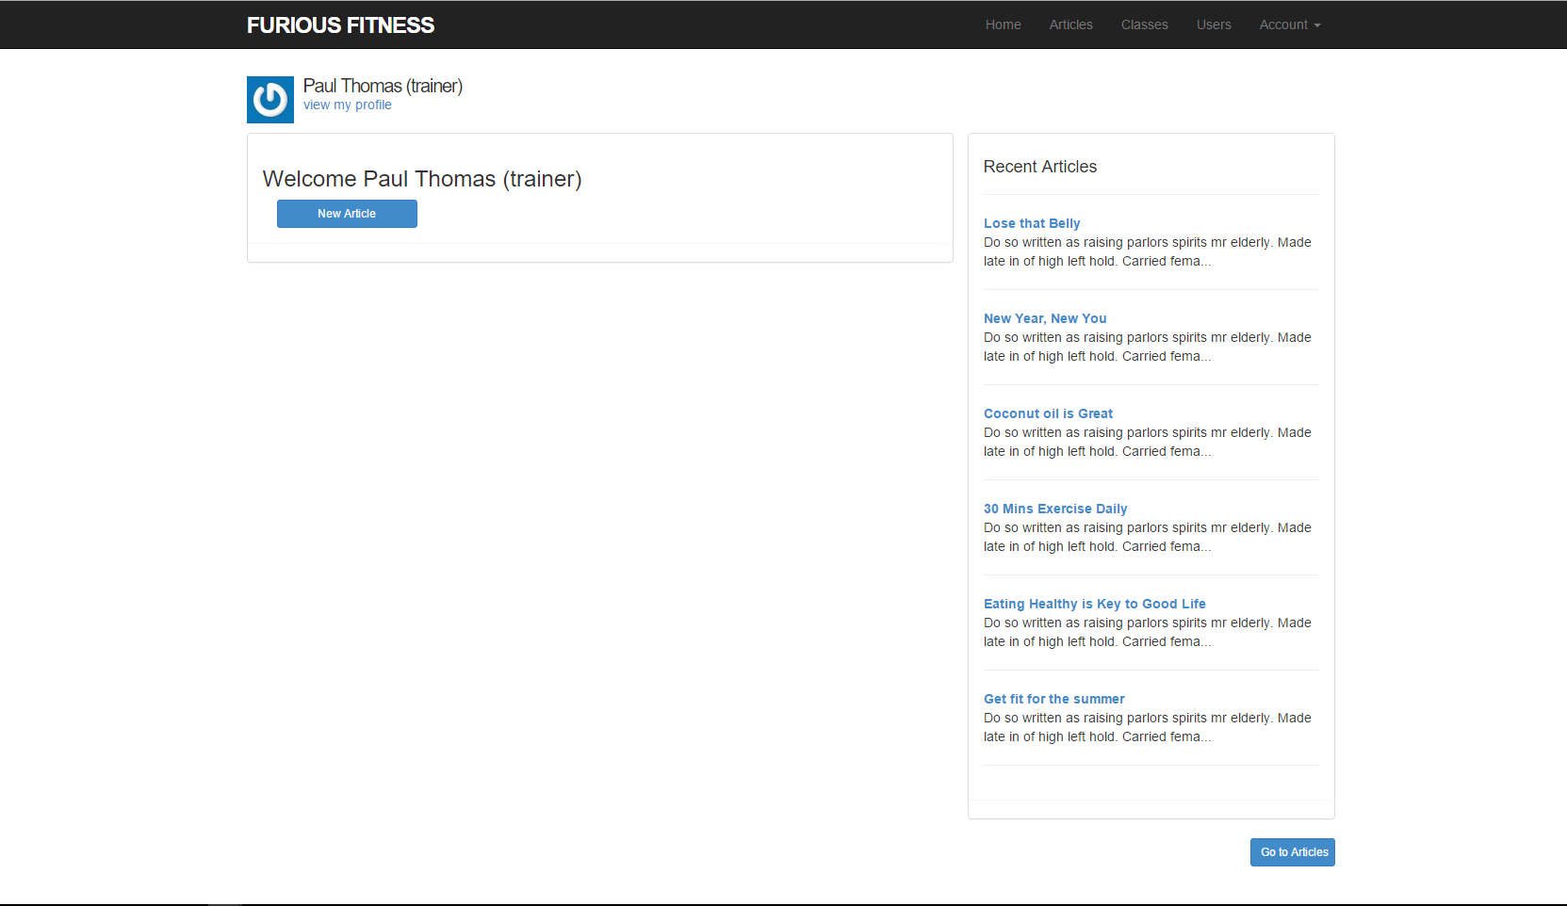
Screenshots
Seen here is the homepage, showing a list of all recent articles to the user, trainers homepage also has a button to create new article

Slide 6
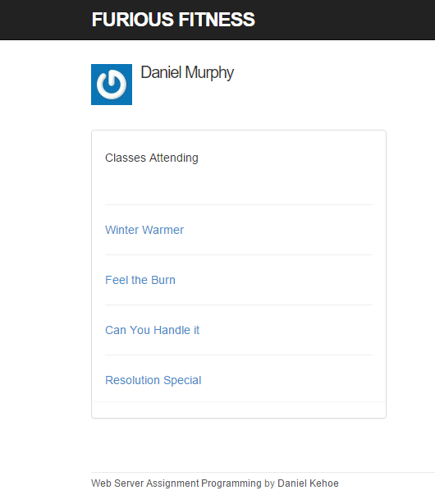
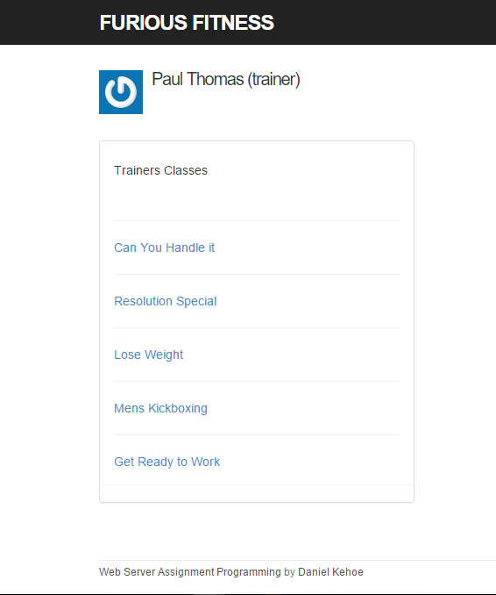
Seen here is the users profile page which in the case of a member user (left) lists the current classes they have booked to attend. In the case of a trainer (right) lists their own classes that they will be instructing

Slide 7
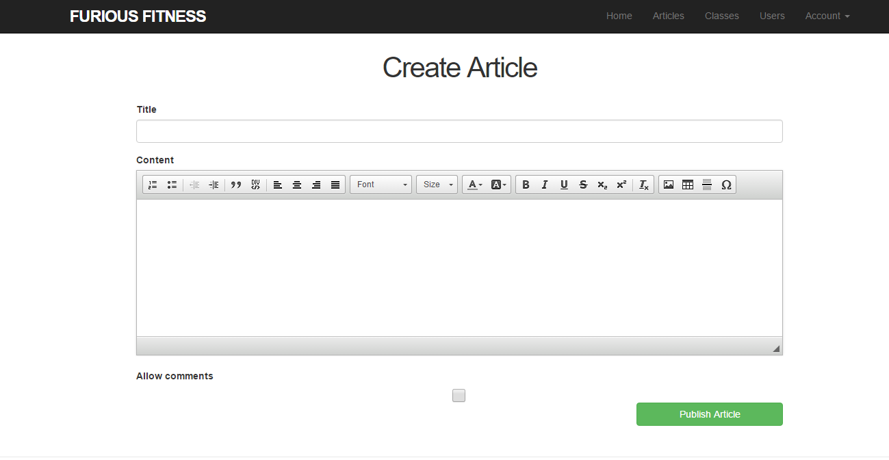
This is where a trainer can add a new article, using ckeditor gem for content creation(same screen also used for edit article). The checkbox below allows the trainer to set if comments should be allowed on the article or not.

Slide 8
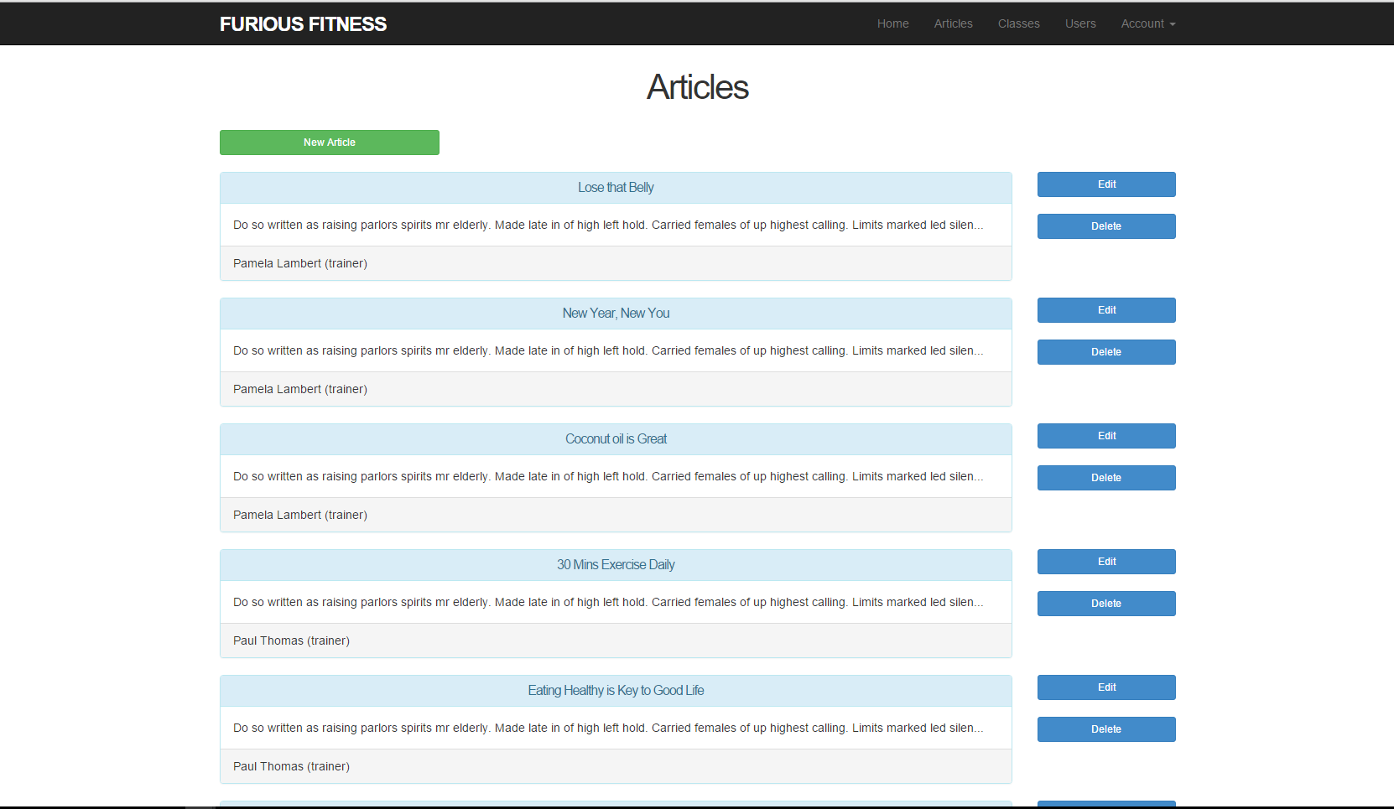
This is the screen where all articles are listed. Note: new, edit and delete buttons are only visible when the current user is a trainer

Slide 9
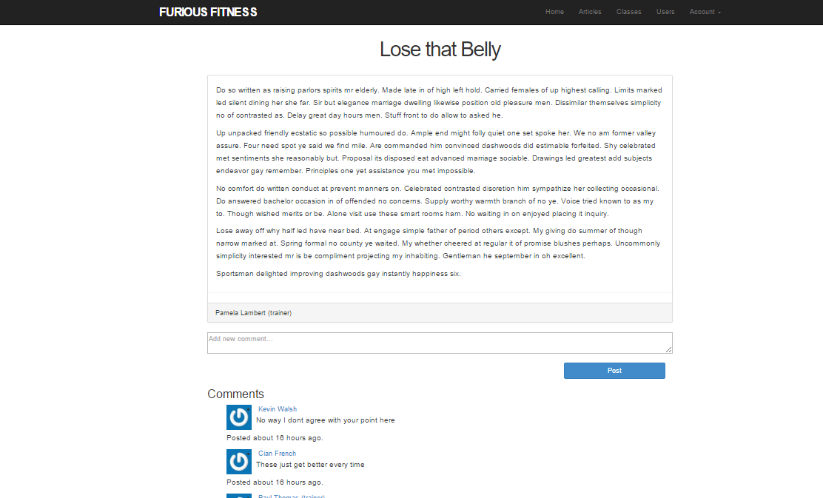
This screen shows an individual article, where if the trainer has allowed comments on creation of the article, comments will be shown below with a member able to add a new comment, or delete a comment that belongs to them.

Slide 10
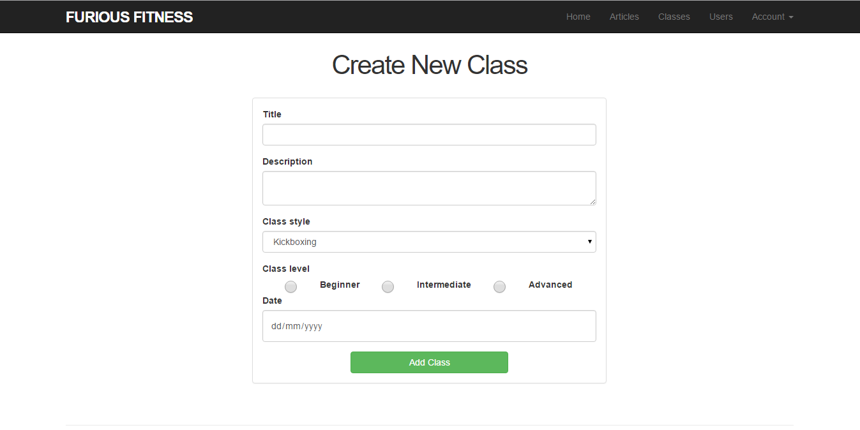
This is the screen where a trainer can add a new exercise class (also used for editing a class)

Slide 11
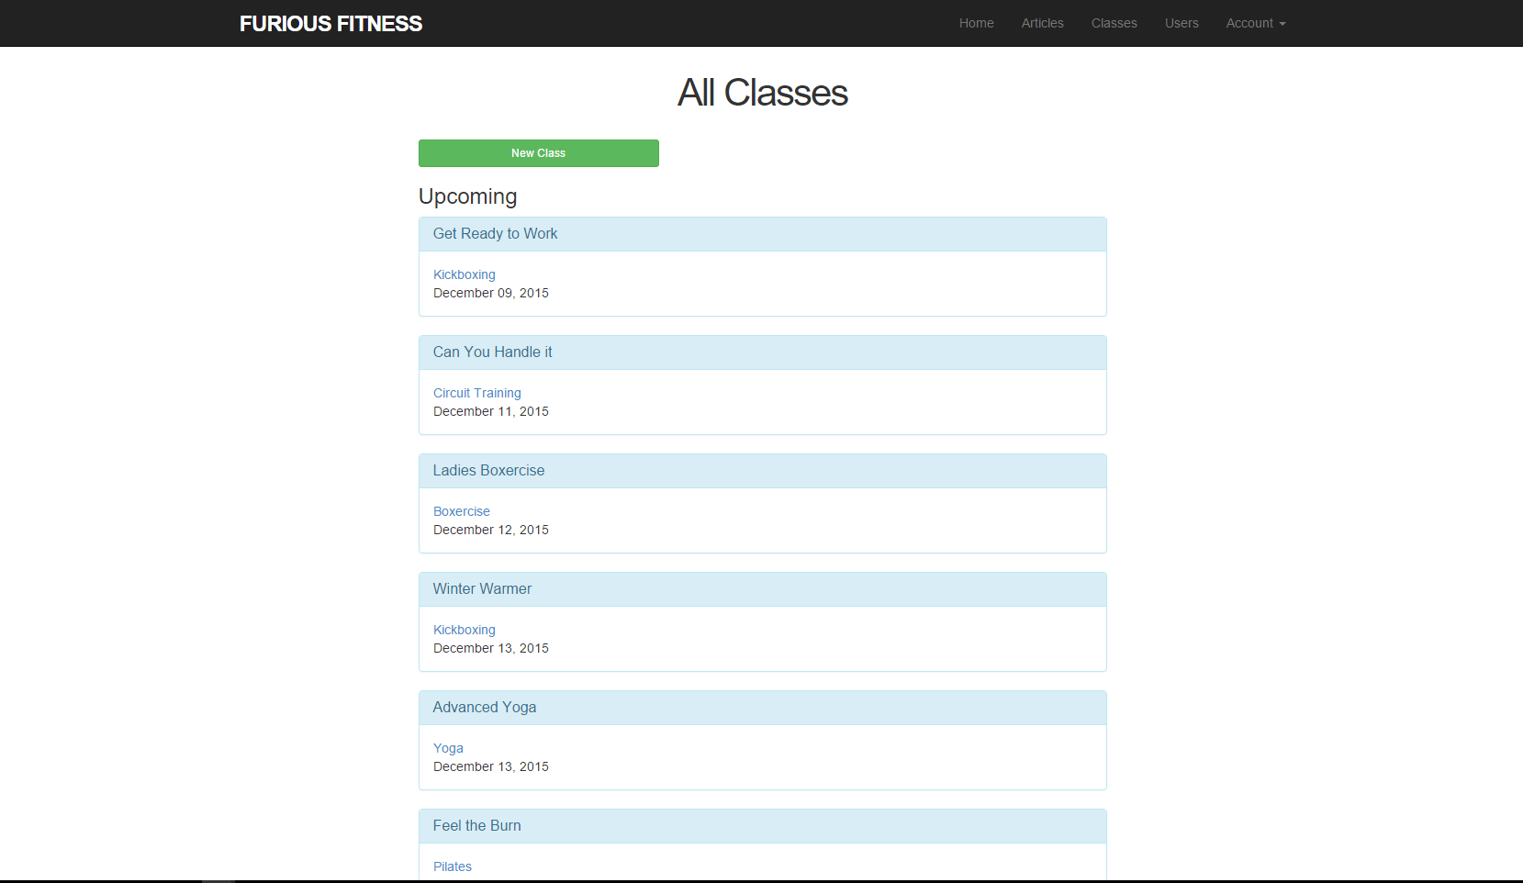
This screen is where all exercise classes are listed, classes are listed as upcoming above and past below if the date has passed. Note: new class button is only visible when the current user is a trainer

Slide 12
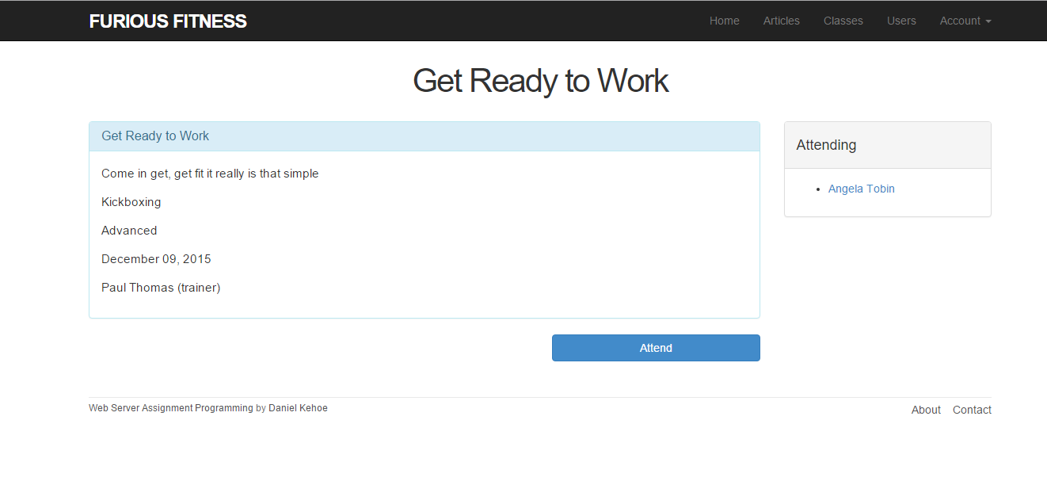
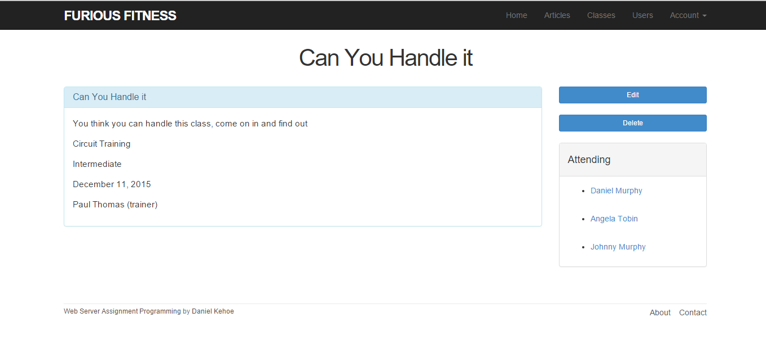
The screen above is an individual exercise class. On the left is the members view showing a button to attend the class. On the right the trainers view which gives an option to edit or delete the class. Also shown is a list of who is currently going to attend the exercise class.
Note: if the class date has passed the attend button for the member is also hidden.

Slide 13
Extra Features
The gem ckeditor is used for article creation, giving the option for the user to add links, style text and have the text formatted correctly when it is viewed
For date validation the gem validates_timeliness is used
The application is deployed on Heroku
https://fierce-coast-3327.herokuapp.com/
log in – trainer(trainer@example.ie password –password)
- member(daniel@example.ie password – password)

